Slide 1

Path Planning
Presentation 12/29/2021

Slide 2
Today we'll focus on the path planning part
Earlier we've seen how to create a Map and Locoalization for SLAM purposes

Slide 3
When node receives goal pose, it links to components (global, planner, local planner, costmaps and recovery behaviors) and outputs a velocity command
The move_base pkg
move_base node: moves robot from its current position to goal position
It takes a goal pose w/ msg type: geometry_msgs/PoseStamped
It sends geometry_msgs/Twist to /cmd_vel Topic

Slide 4
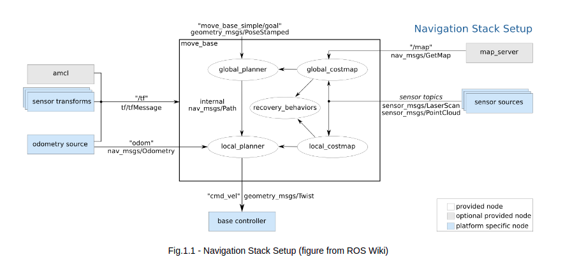
Navigation Stack Setup

Slide 5
DEF: Map representing cost of traversing different areas
Costmaps
Represents either a free space or places where robot would be in collision {0,255}
2 types: global costmap (static map) & local costmap (sensor's readings)
Costmap params defined in 3 files:
1) global_costmap_params.yaml
2) local_costmap_params.yaml
3) common_costmap_params.yaml

Slide 6
2 types: global planner & local planner
Planners
Gp: NavfnROS, Carrot Planner, GlobalPlanner
Lp: DWA (Dynamic Window Approach)
gp in charge of calculating safe path to arrive at goal pose (static map)
Each planner has its own params, which modify the way planner behaves
Note: gp won't calculate dynamic obstacles (bc not in static map)

Slide 7
1) RViz: 2D Nav Goal Tool 2) rostopic pub /move_base/goal move_base_msgs/MoveBaseActionGoal {} 3) Create Action Server : Use actionlib pkg to create servers executing long-running goals Need to define goal, result, feedback msgs (in action dir --> .action file) See send_goal_client.py file Here, action server: move_base
Send a goal pose

Slide 8
Next: Path Planning part 2: Obstacle Avoidance

